Slide 1
CAR INFOTAINMENT USING QT FRAMEWORK
Anushya varshini k,Rithick M K,Gokulnath G
Artificial intelligence and data science, Bannari amman institute of technology , Sathyamangalam , Tamil nadu , India

Slide 2
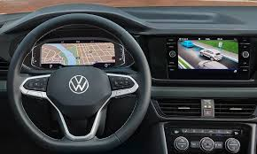
INTRODUCING THE DIGITAL COCKPIT :
Gone are the days of traditional cockpits with limited functionality.
The digital cockpit is here to revolutionize the way we interact
with vehicles. Imagine a cockpit that seamlessly integrates with
All aspects of your vehicles, from navigation to communication
and entertainment. With advanced touch screens, voice
commands, and sensors, the digital cockpit offers an
Unparalleled user experience that enhances safety, efficiency,
and comfort.
A cockpit is located under the windshield of the vehicle. Thanks to this, the driver has easy access to it and does not have to divert his attention from driving to turn on the lights or adjust the air conditioning.

Slide 3
WHAT IS A DIGITAL COCKPIT?
A digital cockpit is a modern interface that replaces traditional gauges and dials in a vehicle with a digital display. It provides real-time information to the driver, including speed, fuel level, and other critical data. The digital cockpit also offers advanced features such as touch screens, and voice commands, that makes driving easier and more efficient.
Compared to traditional cockpits, digital cockpits offer several advantages. They are more user-friendly, providing drivers with immediate access to the information they need. They are also more reliable, reducing the risk of errors due to manual input. Additionally, digital cockpits can be customized to meet the specific needs of each vehicle, allowing for greater flexibility and efficiency.

Slide 4

WORKING ON QT
Building a digital cockpit concept for an automated autonomous vehicle using Qt is a great idea. Qt is a powerful framework that provides tools and libraries for creating cross-platform applications with user interfaces. It offers various features and components that can be utilized to develop a sophisticated digital cockpit for an autonomous vehicle.
Design the User Interface
Implement UI Components
Integrate Vehicle Data
Implement Data Visualization
Handle User Input
Integrate External Services

Slide 5
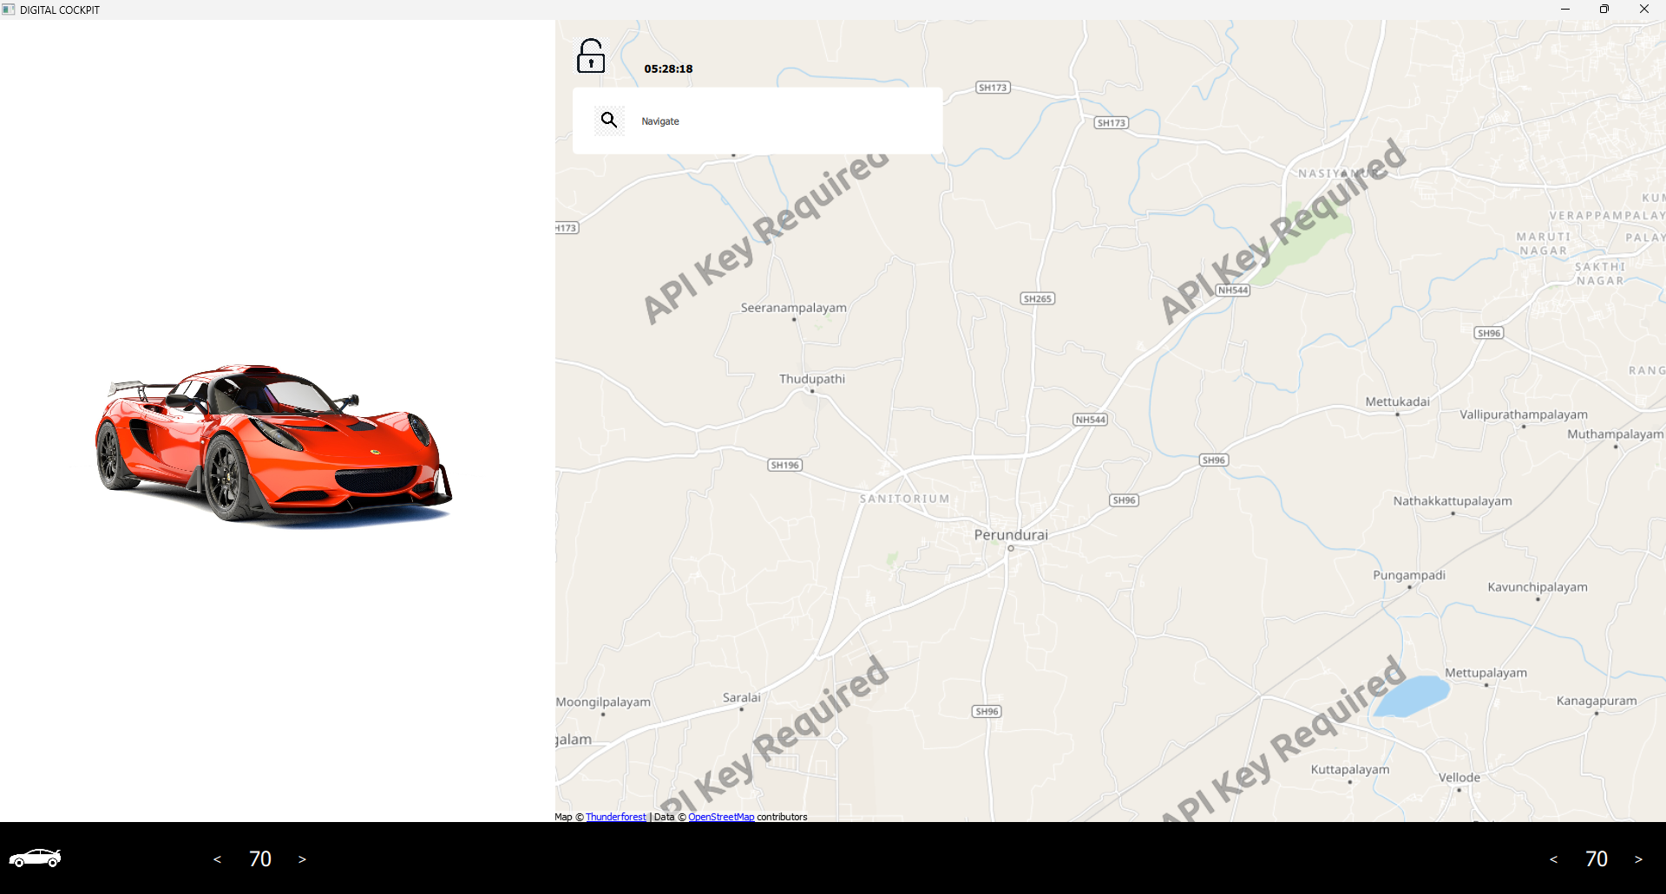
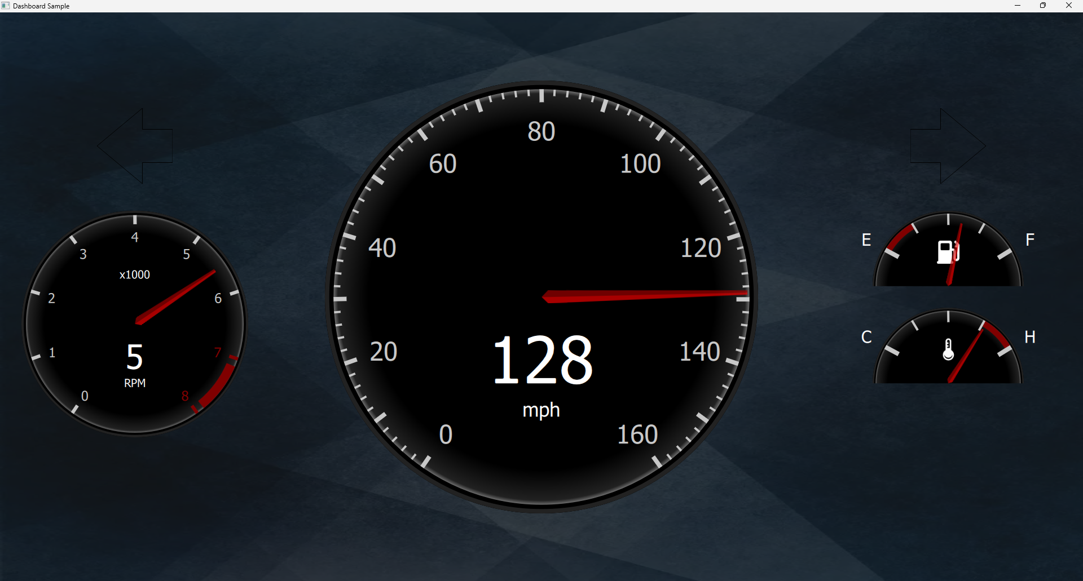
Output
TIME
SEARCH BAR
FUEL
GAUGE
CAR INFO
LOCK BUTTON
RPM
SPEEDOMETER
TEMP
TEMP
GAUGE

Slide 6
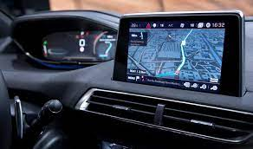
FEATURES OF A DIGITAL COCKPIT :
A digital cockpit has several features that make it stand out from traditional cockpits. One of the most notable features is the use of touch screens. These screens allow drivers to access information quickly and easily, without having to fumble with buttons or switches. For example, a driver can simply swipe through different screens to find the information they need, such as weather reports or location.
Overall, the features of a digital cockpit work together to create a more intuitive and streamlined user experience. Drivers can access information and control the vehicle more efficiently, which can lead to safer and more efficient travel.

Slide 7
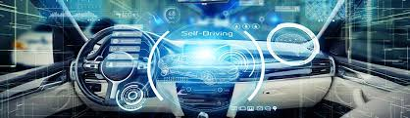
BENEFITS OF A DIGITAL COCKPIT :
In addition to safety, digital cockpits also improve efficiency and comfort. With touch screens and voice commands, driver can access information quickly and easily, allowing them to make decisions faster and more accurately. This not only saves time but also reduces stress and fatigue, leading to a more comfortable driving experience for both the driver and passengers.
A digital cockpit can significantly increase safety by providing real-time information to drivers and reducing the risk of human error.

Slide 8


